Slide 1
Mod 5:Memory System(part2)
BASIC CONCEPTS
SEMICONDUCTOR RAMS
MEMORY SYSTEM CONSIDERATIONS

Slide 2

Some basic concepts
Maximum size of memory that can be used in any computer is determined by address generated.
CPU-Main Memory Connection
Processor
k
-bit
Memory
address bus
MAR
n
-bit
data bus
Up to 2
k
addressable
MDR
locations
Word length =
n
bits
Control lines
R
/
W
( , MFC, etc.)

Slide 3
Some basic concepts
If MAR is k-bits long then
→ memory may contain up to 2^k addressable-locations
If MDR is n-bits long, then
→ n-bits of data are transferred between the memory and processor.
The data-transfer takes place over the processor-bus
The processor-bus has 1) Address-Line2) Data-line &
3) Control-Line (R/W’’, MFC – Memory Function Completed).
The Control-Line is used for coordinating data-transfer.

Slide 4
Some basic concepts
The processor reads the data from the memory by
→ loading the address of the required memory-location into MAR and setting the R/W‟ line to 1.
The memory responds by
→ placing the data from the addressed-location onto the data-lines and
→ confirms this action by asserting MFC signal.
Upon receipt of MFC signal, the processor loads the data from the data-lines into MDR.
The processor writes the data into the memory-location by
→ loading the address of this location into MAR &
→ setting the R/W‟ line to 0.

Slide 5
Some basic concepts(Contd.,)
Measures for the speed of a memory:
memory access time: It is the time that elapses between
initiation of an operation &completion of that operation.
memory cycle time: It is the minimum time delay that required between the initiation of the two successive memory-operations.
An important design issue is to provide a computer system with as large and fast a memory as possible, within a given cost target.
Several techniques to increase the effective size and speed of the memory:
Cache memory (to increase the effective speed).
Virtual memory (to increase the effective size).

Slide 6
Semiconductor RAMS: Internal organization of memory chips
Memory cells are organized in the form of an array.
Each memory cell can hold one bit of information.
Each row of cells forms one memory word.
All cells of a row are connected to a common line, known as the “word line”.
Word line is connected to the address decoder.
The cells in each column are connected to Sense/write circuits by 2 bit lines
Sense/write circuits are connected to the data input/output lines of the memory chip.
During a write operation, the sense/write circuit receive i/p information and store i/p info in the cells of the selected word.

Slide 7
Semiconductor RAMS: Internal organization of memory chips
The data input and data output of each Sense/Write circuit are connected to a single bidirectional data-line.
Data-line can be connected to data-bus of the computer.
Following 2 control lines are also used
1)R/W ‘ →Specifies the required operation.
2)CS’ →Chip select input selects a given chip in the multichip memory system

Slide 8
Internal organization of memory chips (Contd.,)
7
7
1
1
0
0
W
0
•
•
•
FF
FF
A
0
W
1
•
•
•
A
1
Address
Memory
decoder
•
•
•
•
•
•
•
•
•
•
•
•
•
•
•
•
•
•
cells
A
2
A
3
W
15
•
•
•
Sense / Write
Sense / Write
Sense / Write
R
/
W
circuit
circuit
circuit
CS
Data input
/output lines:
b
7
b
1
b
0

Slide 9
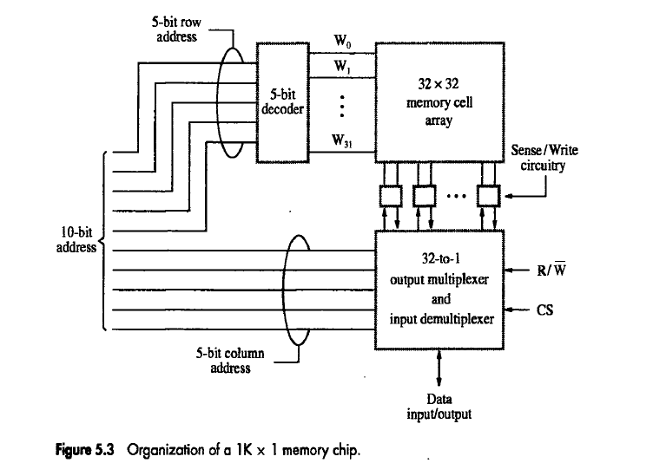
Internal Organization:1K*1 memory chip

Slide 10
1K*1 Internal organization
In 1K*1 organization=10 bit address is needed, but there is only one data line, resulting in 15 external connections(10address,1dataline,2control signals,2power signals)
The required 10 bit address is divided into 2 groups of 5 bits each to form row and column addresses for the cell array.
A row address selects a row of 32 cells ,all of which are accessed in parallel.
According to the column address only one of these cells is connected to the external data line by the output multiplexer and i/p DE multiplexer.

Slide 11
Static memories: RAM Cell
Memories consist of circuits capable of retaining their state as long as power is applied are known as static memories
Two inverters are cross connected to form a latch.
The cell is connected to one word line and two bits lines by transistors T1 and T2
The transistors act as switches which can be opened or closed under the control of word-line.
When word line is at ground level, the transistors are turned off and the latch retains its state.
b
′
b
T
T
1
X
Y
2
Word line
Bit lines

Slide 12
Read & Write operation of static RAM
READ operation
To read the state of the cell, the word-line is activated to close switches T1,T2
If the cell is in state 1,the signal on bit line b is high and bit-line b’ is low. b and b’ are complement of each other
Sense/write circuits: monitors the state of b and b’ & sets the output accordingly
WRITE operation
The state of the cell is set by placing the appropriate value on bit line b and its complement on b’
Then activating the word-line. This forces the cell into the corresponding state.
The required signal on the bit lines is generated by sense/write circuit

Slide 13
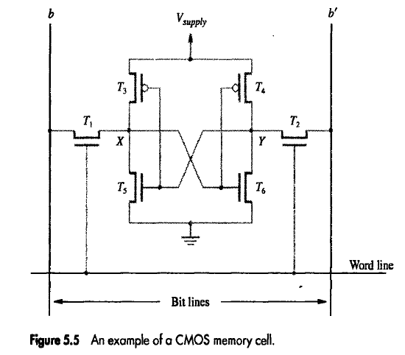
CMOS CELL-characteristics
Volatile
Low power consumption--no current flows except when being accessed
Fast--access times of a few nanoseconds
Expensive (6 transistors per cell)

Slide 14
CMOS CELL
CMOS Cell
Transistor pairs (T3, T5) and (T4, T6) form the inverters in the latch
Advantages:
1) It has low power consumption because the current flows in the cell only when the cell is active.
2) Static RAM’s can be accessed quickly. It access time is few nanoseconds.
Disadvantage: SRAMs are said to be volatile memories because their contents are lost when power is interrupted

Slide 15
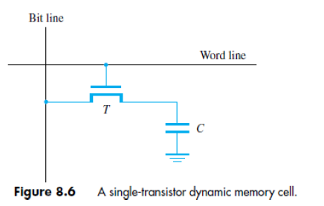
ASYNCHRONOUS DRAM
Less expensive RAMs can be implemented if simple cells are used.
Such cells cannot retain their state indefinitely. Hence they are called Dynamic RAM (DRAM).
The information stored in a dynamic memory-cell in the form of a charge on a capacitor. This charge can be maintained only for tens of milliseconds.
The contents must be periodically refreshed by restoring this capacitor charge to its full value.

Slide 16
Bit line
Word line
capacitor is charged to write a 1
(voltage applied to Word line and to the Bit line)
charge on the capacitor will discharge over time
T
C
Figure 5.6. A single-transistor dynamic memory cell

Slide 17
Figure 5.6. A single-transistor dynamic memory cell
Bit line
Word line
If a Read detects a voltage on the capacitor above the “threshold, ” it “sees” a 1, and drives the bit line to full voltage and recharges the capacitor
T
If a Read detects a voltage on the capacitor below the “threshold, ” it “sees” a 0, and drives the bit line to ground and fully discharges the capacitor
C
Refreshes whenever read
Refresh circuit will periodically read all cells

Slide 18
ASYNCHRONOUS DRAM(contd..)
In order to store information in the cell, the transistor T is turned „ON
The appropriate voltage is applied to the bit-line which charges the capacitor.
After the transistor is turned off, the capacitor begins to discharge.
Hence, info. stored in cell can be retrieved correctly before threshold value of capacitor drops down.
During a read-operation,
→ transistor is turned ON(switch closed)
→ a sense amplifier detects whether the charge on the capacitor is above the threshold value.
If (charge on capacitor) > (threshold value) → Bit-line will have logic value 1.
➢ If (charge on capacitor) < (threshold value) → Bit-line will set to logic value 0.

Slide 19
Asynchronous DRAMs: Internal organization
Each row can store 512 bytes. 12 bits to select a row, and 9 bits to select a group in a row. Total of 21 bits.
First apply the row address, RAS signal latches the row address. Then apply the column address, CAS signal latches the address.
Timing of the memory unit is controlled by a specialized unit which generates RAS and CAS.
This is asynchronous DRAM
R
A
S
Row
Row
4096
×
(
512
×
8
address
)
latch
decoder
cell array
A
20
⁄
A
Sense / Write
CS
-
9
8
-
0
circuits
R
/
W
Column
Column
address
decoder
latch
C
A
S
D
D
7
0

Slide 20
4096 lines
R
A
S
12 bits to select one of the 4096 rows
Row address latch
Row decoder
4096 x (512 x 8) cell array
4096 lines
A
/
20
-
9
A
8
-
0
Sense / Write circuits
CS
R
/
W
9 bits to select one of the 512 bytes in a row
Column address latch
Column decoder
C
A
S
D
D
7
0
the selected byte
Figure 5.7. Internal organization of a 2M x 8 dynamic memory chip.
16 megabits, 2 million bytes

Slide 21
Row Address Strobe
1
R
A
S
12 bit row address applied, latched on RAS
Row address latch
Row decoder
4096 x (512 x 8) cell array
21 bit address on 12 lines (reduces external connections)
Sense / Write circuits
CS
R
/
W
Column address latch
Column decoder
2
9 bit column address applied, latched on CAS
C
A
S
D
D
7
0
Column Address Strobe
the selected byte

Slide 22
Asynchronous DRAMs:internal organization
During Read/Write-operation,→ row-address is applied first.→ row-address is loaded into row-latch in response to a signal pulse on RAS’ input of chip.(RAS = Row-address Strobe CAS = Column-address Strobe)
When a Read-operation is initiated, all cells on the selected row are read and refreshed. Shortly after the row-address is loaded, the column-address is→ applied to the address pins &→ loaded into CAS’.
The information in the latch is decoded.
The appropriate group of 8 Sense/Write circuits is selected.
R/W’=1(read-operation) → Output values of selected circuits are transferred to data-lines D0-D7.R/W’=0(write-operation) → Information on D0-D7 are transferred to the selected circuits.
RAS‟ & CAS‟ are active-low so that they cause latching of address when they change from high to low.
To ensure that the contents of DRAMs are maintained, each row of cells is accessed periodically.
A special memory-circuit provides the necessary control signals RAS‟ & CAS‟ that govern the timing.
The processor must take into account the delay in the response of the memory.

Slide 23
Fast Page Mode
Suppose if we want to access the consecutive bytes in the selected row.
This can be done without having to reselect the row.
Add a latch at the output of the sense circuits in each row.
All the latches are loaded when the row is selected.
Different column addresses can be applied to select and place different bytes on the data lines.
Consecutive sequence of column addresses can be applied under the control signal CAS, without reselecting the row.
Allows a block of data to be transferred at a much faster rate than random accesses.
A small collection/group of bytes is usually referred to as a block.
This transfer capability is referred to as the
fast page mode feature.

Slide 24
SDRAM characteristics
Can operate in different modes
“Burst” modes of different lengths
Can transfer “blocks” of data on single Read or Write

Slide 25
Synchronous DRAMs
Operation is directly synchronized
with processor clock signal.
The outputs of the sense circuits are
connected to a latch.
During a Read operation, the
contents of the cells in a row are
loaded onto the latches.
During a refresh operation, the
contents of the cells are refreshed
without changing the contents of
the latches.
Data held in the latches correspond
to the selected columns are transferred
to the output.
For a burst mode of operation,
successive columns are selected using
column address counter and clock.
CAS signal need not be generated
externally. A new data is placed during
raising edge of the clock
Refresh
counter
Row
Ro
w
address
decoder
Cell array
latch
Row/Column
address
Column
Co
lumn
Read/Write
address
decoder
circuits & latches
counter
Clock
R
A
S
Mode register
C
A
S
and
Data input
Data output
R
/
W
timing control
register
register
C
S
Data

Slide 26
Refresh counter
Row address latch
Row decoder
Cell array
Row/Column address
Entire row can be addressed and put into latches
Successive columns put into output register on successive clock pulses
Column address counter
Read/Write circuits & latches
Columndecoder
Clock
Mode register and timing control
R
A
S
Data input register
Data output register
C
A
S
R
/
W
C
S
Clock pulses cause “counting” to select successive columns
Data
Figure 5.8. Synchronous DRAM.

Slide 27
Clock
R
/
W
R
A
S
C
A
S
Address
Row
Col
Data
D0
D1
D2
D3
column address automatically incremented by memory control each cycle
row address latched
2 cycles to activate selected row
column address latched
1 cycle to put data on data lines
Figure 5.9. Burst read of length 4 in an SDRAM.

Slide 28
LATENCY & BANDWIDTH
A good indication of performance is given by 2 parameters: 1) Latency 2) Bandwidth.
Latency
• It refers to the amount of time it takes to transfer a word of data to or from the memory.
• For a transfer of single word, the latency provides the complete indication of memory performance.
• For a block transfer, the latency denotes the time it takes to transfer the first word of data.
Bandwidth: It is defined as the number of bits or bytes that can be transferred in one second.
• Bandwidth mainly depends on1) The speed of access to the stored data & 2) The number of bits that can be accessed in parallel.
bandwidth-=rate at which data transferred*width of databus

Slide 29
DOUBLE DATA RATE SDRAM (DDR-SDRAM)
The standard SDRAM performs all actions on the rising edge of the clock signal. Fastest version of SDRAM
The DDR-SDRAM transfer data on both the edges (loading edge, trailing edge).
The Bandwidth of DDR-SDRAM is doubled for long burst transfer.
To make it possible to access the data at high rate, the cell array is organized into two banks.
Each bank can be accessed separately.
Consecutive words of a given block are stored in different banks.
Such interleaving of words allows simultaneous access to two words.
The two words are transferred on successive edge of the clock.

Slide 30
Structure of larger memories: Static m/m systems
21-bit
19-bit internal chip address
Implement a memory unit of 2M
words of 32 bits each.
Use 512x8 static memory chips.
Each column consists of 4 chips.
Each chip implements one byte
position.
A chip is selected by setting its
chip select control line to 1.
Selected chip places its data on the
data output line, outputs of other
chips are in high impedance state.
21 bits to address a 32-bit word.
High order 2 bits are needed to
select the row, by activating the
four Chip Select signals.
19 bits are used to access specific
byte locations inside the selected
chip.
A
addresses
A
0
1
A
19
A
20
2-bit
decoder
512
K
×
8
memory chip
D
D
D
D
31-24
23-16
15-8
7-0
512
K
×
8
memory chip
19-bit
8-bit data
address
input/output
Chip select

Slide 31
Structure of larger memories: Dynamic m/m systems
Dynamic Memory System
• The physical implementation is done in the form of memory-modules.
• If a large memory is built by placing DRAM chips directly on the Motherboard, then it will occupy large amount of space on the board.
• These packaging consideration have led to the development of larger memory units known as SIMM’s& DIMM’s.
1) SIMM → Single Inline memory-module
2) DIMM → Dual Inline memory-module
• SIMM/DIMM consists of many memory-chips on small board that plugs into a socket on motherboard

Slide 32
Memory system considerations
MEMORY CONTROLLER
• To reduce the number of pins, the dynamic memory-chips use multiplexed-address inputs.
• The address is divided into 2 parts:
1) High Order Address Bit➢ Select a row in cell array.
➢ It is provided first and latched into memory-chips under the control of RAS‟ signal.
2) Low Order Address Bit➢ Selects a column.
➢ They are provided on same address pins and latched using CAS‟ signals.
• The Multiplexing of address bit is usually done by Memory Controller Circuit

Slide 33
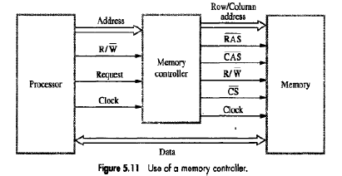
Memory system considerations
The Controller accepts a complete address & R/W‟ signal from the processor.
A Request signal indicates a memory access operation is needed.
Then, the Controller
→ forwards the row & column portions of the address to the memory.
→ generates RAS‟ & CAS‟ signals &sends R/W‟ & CS‟ signals to the memory.

Slide 34
RAMBUS Memory
RAMBUS MEMORY
The usage of wide bus is expensive. Rambus developed the implementation of narrow bus.
Rambus technology is a used to transfer information between chips. The signals consist of much smaller voltage swings around a reference voltage Vref. The reference voltage is about 2V.
The two logical values are represented by 0.3V swings above and below Vref.This type of signaling is generally is known as Differential Signalling.
Rambus provides a complete specification for design of communication Links called as Rambus Channel.
Rambus memory has a clock frequency of 400 MHz.
The data are transmitted on both the edges of clock so that effective data-transfer rate is 800MHZ.

Slide 35
RAMBUS Memory(contd…)
Circuitry needed to interface to Rambus channel is included on chip. Such chips are called RDRAM.(RDRAM = Rambus DRAMs).
Rambus channel has:1) 9 Data-lines (1st-8th line ->Transfer the data, 9th line->Parity checking2) Control-Line &3) Power line.
A two channel rambus has 18 data-lines which has no separate Address-Lines.
Communication between processor and RDRAM modules is carried out by means of packets transmitted on the data-lines.
There are 3 types of packets:1) Request2) Acknowledge &
3) Data

